Slide 1
What is Spring Boot?
Spring Boot is a framework built on top of the Spring Framework that simplifies the development of Java applications by providing:
Auto-configuration
Embedded servers
Production-ready features
Definition (Interview-ready):
Spring Boot is a Spring-based framework used to build stand-alone, production-ready Java applications with minimal configuration.
Here Stand-alone Spring Boot application means, A Java application that starts using a main() method and runs an embedded web server (Tomcat/Jetty/Undertow) internally. Just run:
public static void main(String[] args) {
SpringApplication.run(MyApp.class, args);
}
App starts by itself, That’s why it’s called stand-alone

Slide 2
Goals
Spring Boot is designed with the following goals −
Simpler Configuration− To avoid complex XML configuration in Spring. With very few annotations, we can achieve the same configurations.
Ease of Development− To develop a production ready Spring applications in an easier way.
Reduce Development Efforts− To reduce the development time and run the application independently.
Easy Deployment− Offer an easier way of getting started with the application by providing an embedded application container to test the application locally.

Slide 3
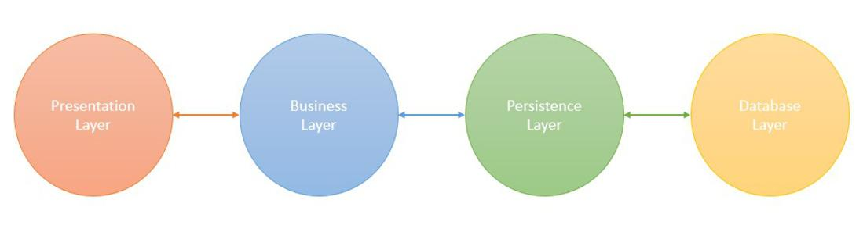
Spring Boot - Architecture
Spring Boot is built on top of the Spring Framework and follows a layered architecture. Its primary goal is to simplify application development by providing auto-configuration, embedded servers and a production-ready environment out of the box.
The architecture of Spring Boot can be divided into several layers and components, each playing an important role in building and running modern applications.
Spring Boot Architecture Layers
Spring Boot consists of the following four layers:

Slide 4
1. Presentation Layer
Handles HTTP requests through REST controllers (GET, POST, PUT, DELETE).
Manages authentication, request validation and JSON serialization/deserialization.
Forwards processed requests to the Business Layer for further logic.
2. Business Layer
The Business Layer is responsible for implementing the application's core logic. It consists of service classes that:
Process and validate data.
Handle authentication and authorization (integrating Spring Security if needed).
Apply transaction management using @Transactional.
Interact with the Persistence Layer to store or retrieve data.

Slide 5
3. Persistence Layer
The Persistence Layer manages database transactions and storage logic. It consists of repository classes using Spring Data JPA, Hibernate for data access. It is responsible for:
Mapping Java objects to database records using ORM frameworks.
Managing CRUD (Create, Read, Update, Delete) operations.
Supporting relational and NoSQL databases.
4. Database Layer
The Database Layer contains the actual database where the application data is stored. It can support:
Relational Databases (MySQL, PostgreSQL, Oracle, SQL Server).
NoSQL Databases (MongoDB, Cassandra, DynamoDB, Firebase).
Cloud-based databases for scalability.

Slide 6
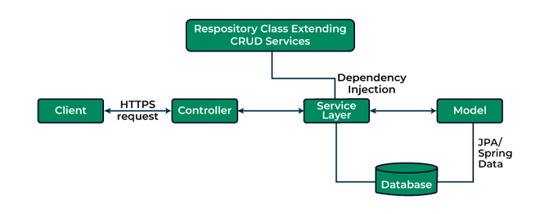
Spring Boot Flow Architecture

Slide 7
Explanation:
The client (frontend or API consumer) sends an HTTP request (GET, POST, PUT, DELETE) to the application.
The request is handled by the Controller Layer, which maps the request to a specific handler method.
The Service Layer processes business logic and communicates with the Persistence Layer to fetch or modify data.
The Persistence Layer interacts with the Database Layer using Spring Data JPA or R2DBC, often through a Repository Class that extends CRUD services.
The processed response is returned as JSON.

Slide 8
Why to Learn Spring Boot?
Flexibility− Spring Boot provides multiple flexible ways to configure Java Beans, XML configurations, and Database Transactions.
Powerful Batch Processing− Spring Boot provides powerful batch processing by integrating Spring Batch to efficiently process large volumes of data in scheduled or background jobs.
Microservices Support− Micro Service is an architecture that allows the developers to develop and deploy services independently. Each service running has its own process and this achieves the lightweight model to support business applications. Spring Boot provides mechanism to develop and test microservices easily.
Auto Configuration− In Spring Boot, everything is auto configured; no manual configurations are needed.

Slide 9
Annotation Based− In Spring Boot, we can create a running application with very few annotations.
Eases dependency management− Spring Boot provides many starters as per need like for web, for database etc to handle dependencies effectively. A starter project provides dependency management for corresponding functionalities.
Embedded Servlet Container− Spring Boot provides an embedded servlet container(jetty) which can be changed as well. This container is very useful while testing the application. We can test all functionalities without deploying the spring boot application on any external application container.

Slide 10
Why Spring Boot? (Need of Spring Boot)
Problems in Traditional Spring Applications
Large XML configuration
Manual dependency management
External server configuration
Longer development time
Difficult initial setup for beginners
Why Spring Boot Was Introduced
Spring Boot was introduced to:
Reduce boilerplate code
Eliminate XML-based configuration
Provide faster application startup
Simplify deployment and maintenance
One-line reason:
Spring Boot increases developer productivity.

Slide 11
Applications of Spring Boot
POJO Based − Spring Boot enables developers to develop enterprise−class applications using POJOs. The benefit of using only POJOs is that you do not need an EJB container product such as an application server but you have the option of using only a robust servlet container such as Tomcat or some commercial product.
Modular − Spring Boot is modular by nature. Even though the number of packages and classes are substantial(in large number), you have to worry only about the ones you need and ignore the rest.
Integration with existing frameworks − Spring Boot does not create new tools for everything. Instead, it smartly uses already popular and proven frameworks and makes them easy to integrate.

Slide 12
Testablity − Testing an application written with Spring Boot is very easy because environment−dependent code is moved into this framework. Furthermore, by using Java Bean style POJOs, it becomes easier to use dependency injection for injecting test data.
Web MVC − Spring Boot's web framework is a well−designed web MVC framework, which provides a great alternative to web frameworks such as Struts or other over−engineered or less popular web frameworks.
Central Exception Handling − Spring Boot provides a convenient API to translate technology−specific exceptions (thrown by JDBC, Hibernate, or JDO, for example) into consistent, unchecked exceptions.
Lightweight − Lightweight IoC containers tend to be lightweight, especially when compared to EJB containers, for example. This is beneficial for developing and deploying applications on computers with limited memory and CPU resources.
Transaction management − Spring Boot provides a consistent transaction management interface that can scale down to a local transaction (using a single database, for example) and scale up to global transactions (using JTA, for example).

Slide 13
Position of Spring Boot in Technology Stack
Frontend (React / Angular / HTML)
↓
Spring Boot (Controllers, Services, APIs)
↓
Spring Framework (Core, MVC, Security, JPA)
↓
Hibernate / JPA
↓
Database (MySQL, PostgreSQL, MongoDB)
↓
Server / Cloud (Tomcat, AWS, Azure)
Important Point:
Spring Boot does NOT replace Spring — it uses Spring internally.

Slide 14
Where Can We Use Spring Boot?
Spring Boot is used wherever Java-based backend applications are required.
Common Use Cases
Enterprise Applications
Web Applications
RESTful APIs
Microservices
Cloud-native applications
Backend for mobile apps
Backend for SPA (React / Angular / Vue)
Industry Reality:
Most modern Java backend projects use Spring Boot.

Slide 15
What Can We Build Using Spring Boot?
🔹 Web Applications
MVC-based applications
Login / Registration systems
Admin dashboards
🔹 REST APIs
JSON-based APIs
Used by frontend & mobile apps
🔹 Microservices
Independent, scalable services
Communicate using REST or messaging
🔹 Enterprise Applications
Banking systems
ERP systems
CRM applications
🔹 Cloud Applications
Deployed on AWS / Azure / GCP
Docker & Kubernetes support
🔹 Batch & Standalone Applications
File processing
Scheduled jobs
Background services

Slide 16
Spring Boot in Modern Application Development
Why Companies Prefer Spring Boot
Faster time to market
Easy cloud deployment
Microservice-ready
Strong ecosystem
Long-term support
Interview Statement:
Spring Boot is the backbone of modern Java backend development.

Slide 17
Real-World Example
Example: Online Shopping Application
Frontend: React / Angular
Backend: Spring Boot REST APIs
Database: MySQL / MongoDB
Cloud: AWS / Azure
Security: Spring Security + JWT

Slide 18
What is Micro Service?
Micro Service is an architecture that allows the developers to develop and deploy services independently. Each service running has its own process and this achieves the lightweight model to support business applications.
Microservices are an architectural approach where a single application is composed of many small, loosely coupled, and independently deployable components or services. Microservices are autonomous: Each microservice can be developed, deployed, and operated independently without affecting other services.
In a monolithic architecture, all processes run as a single service, tightly coupled. Microservices break down an application into independent components, each running as a separate service.

Slide 19
Advantages of Microservices
Micro services offers the following advantages to its developers −
Easy deployment
Simple scalability
Compatible with Containers
Minimum configuration
Lesser production time

Slide 20
Some Key Points :
If you add spring-boot-starter-web dependency → embedded Tomcat comes automatically.
Without spring-boot-starter-web → your app won’t have an embedded web server.
<dependency>
<groupId>org.springframework.boot</groupId>
<artifactId>spring-boot-starter-web</artifactId>
</dependency>
spring-boot-starter-web includes:
Spring MVC
Embedded Tomcat server
Jackson (for JSON)
You don’t need to install Tomcat separately.

Slide 21
Spring Boot Execution Flow
You add spring-boot-starter-web dependency
Maven downloads all required dependencies (embedded Tomcat included)
You run the Spring Boot application
SpringApplication.run(DemoApplication.class, args) executes
Spring creates ApplicationContext and initializes beans
Embedded Tomcat starts automatically (default port 8080)
Application is deployed internally into embedded Tomcat
DispatcherServlet is configured and mapped
Your application becomes a running web server
Application is accessible at: http://localhost:8080
No WAR file required
No external Tomcat installation needed
Note: Embedded server means your Spring Boot app itself runs a server internally. You don’t need external Tomcat. But it works only if you include the correct starter dependency, usually spring-boot-starter-web.

Slide 22
Traditional Spring vs Spring Boot (Server Aspect)
Feature | Traditional Spring | Spring Boot
Server | External Tomcat | Embedded Tomcat
Deployment | WAR | JAR
Setup | Manual | Automatic

Slide 23
Why “Run as → Java Application” in Spring Boot?
Because Spring Boot has an embedded server, the application:
Starts like a normal Java program
The embedded Tomcat starts inside the JVM
No external server is required
So, Eclipse shows: Run As → Java Application
When you run: SpringApplication.run(MyApplication.class, args), Spring Boot:
Creates ApplicationContext
Loads all beans
Starts embedded Tomcat
Deploys your app internally
Opens port 8080
That’s why no “Run on Server” is needed

Slide 24
Recall ApplicationContext
ApplicationContext is the Spring container that creates, manages, and controls all Spring beans during the application lifecycle.
In Simple Words
A factory for objects (beans)
A manager that:
Creates objects
Injects dependencies
Manages lifecycle
Applies configuration
Without ApplicationContext → No Spring

Slide 25
Types of ApplicationContext
Common Types:
ClassPathXmlApplicationContext
AnnotationConfigApplicationContext
WebApplicationContext
In Spring Boot:
AnnotationConfigApplicationContext
ServletWebServerApplicationContext (for web apps)
In Spring Boot, You do NOT create ApplicationContext manually, It is created automatically by: SpringApplication.run(MyApplication.class, args);
Internally:
ApplicationContext context = SpringApplication.run(MyApplication.class, args);

Slide 26
Traditional Spring / Servlet Project (Comparison)
In Traditional Servlet / Spring MVC:
No embedded server
Needs external Tomcat
So, IDE shows: Run As → Run on Server
In Spring Boot:
Embedded Tomcat inside JAR
So, IDE shows: Run As → Java Application

Slide 27
Spring Boot Starters
Handling dependency management is a difficult task for big projects. Spring Boot resolves this problem by providing a set of dependencies for developers convenience.
For example, if you want to use Spring and JPA for database access, it is sufficient if you include spring-boot-starter-data-jpa dependency in your project.
Note that all Spring Boot starters follow the same naming pattern spring-boot-starter- *, where * indicates that it is a type of the application.

Slide 28
Examples
Look at the following Spring Boot starters explained below for a better understanding −
Spring Boot Starter Actuator dependency is used to monitor and manage your application. Its code is shown below −
<dependency>
<groupId>org.springframework.boot</groupId>
<artifactId>spring-boot-starter-actuator</artifactId>
</dependency>
Common Actuator Endpoints (Must Know) Endpoint
/actuator/health | Shows app health (UP / DOWN)
/actuator/info | App information
/actuator/metrics | Performance metrics
/actuator/env | Environment properties
/actuator/beans | All Spring beans
/actuator/mappings | URL mappings
/actuator/loggers | Change log levels

Slide 29
Spring Boot Starter Security dependency is used for Spring Security. Its code is shown below −
<dependency>
<groupId>org.springframework.boot</groupId>
<artifactId>spring-boot-starter-security</artifactId>
</dependency>
Spring Boot Starter web dependency is used for Creating REST APIs, Creating web controllers, Handling HTTP requests & responses and many more -
<dependency>
<groupId>org.springframework.boot</groupId>
<artifactId>spring-boot-starter-web</artifactId>
</dependency>

Slide 30
Spring Boot Starter Thyme Leaf dependency is used to create a web application. Its code is shown below −
<dependency>
<groupId>org.springframework.boot</groupId>
<artifactId>spring-boot-starter-thymeleaf</artifactId>
</dependency>
Spring Boot Starter Test dependency is used for writing Test cases. Its code is shown below −
<dependency&gt
<groupId>org.springframework.boot</groupId>
<artifactId>spring-boot-starter-test</artifactId>
</dependency>

Slide 31
Spring Boot Application
The entry point of the Spring Boot Application is the class contains @SpringBootApplication annotation. This class should have the main method to run the Spring Boot application.
@SpringBootApplication annotation includes
Auto- Configuration
Component Scan
Spring Boot Configuration.
If you added @SpringBootApplication annotation to the class, you do not need to add the :
@EnableAutoConfiguration
@ComponentScan
@SpringBootConfiguration annotation.
The @SpringBootApplication annotation includes all other annotations.

Slide 32
Observe the following code for a better understanding −
DemoApplication.java
package com.packageName;
import org.springframework.boot.SpringApplication;
import org.springframework.boot.autoconfigure.SpringBootApplication;
@SpringBootApplication
public class DemoApplication {
public static void main(String[] args) { SpringApplication.run(DemoApplication.class, args);
}
}

Slide 33
Ways to Create a Spring Boot Project Structure
There are three ways to create a Spring Boot project structure:
1. Using Spring Boot CLI : We can create a Spring Boot project structure using the Spring Boot Command Line Interface (CLI).
2. Using Spring Initializer (Recommended) : We can create a Spring Boot project structure using Spring Initializer, which is the most recommended and widely used approach.
3. Using STS (Spring Tool Suite) : We can also create a Spring Boot project structure using Spring Tool Suite (STS). STS can be used in the following ways:
STS as a standalone IDE
STS with IntelliJ IDEA
STS plugin for Eclipse

Slide 34
Steps to Create a Spring Boot Application using Spring Initializer
Step 1: Open Spring Initializer in a browser https://start.spring.io
Step 2: Configure Project Metadata
Fill the required details:
Project: Maven Project
Language: Java
Spring Boot Version: Default (recommended)
Group: com.example
Artifact: demo
Name: demo
Packaging: Jar
Java Version: 17 (or as required)

Slide 35
Step 3 : Add Dependencies
Select required dependencies such as:
Spring Web
Spring Data JPA
MySQL Driver
Spring Security (optional)
Thymeleaf (optional)
Click Add Dependencies
Step 4 : Generate the Project
Click on Generate A ZIP file will be downloaded.
Step 5 : Extract the Project
Unzip the downloaded file into your preferred directory.

Slide 36
Step 6 : Import Project into IDE
Import the project into your IDE:
Eclipse / STS → Import → Maven -> Existing Maven Project
IntelliJ → Open Project
Step 7 : Run the Application
Run the main class:
@SpringBootApplication
public class DemoApplication {
public static void main(String[] args) {
SpringApplication.run(DemoApplication.class, args);
}
}
Right-click → Run as → Java Application

Slide 37
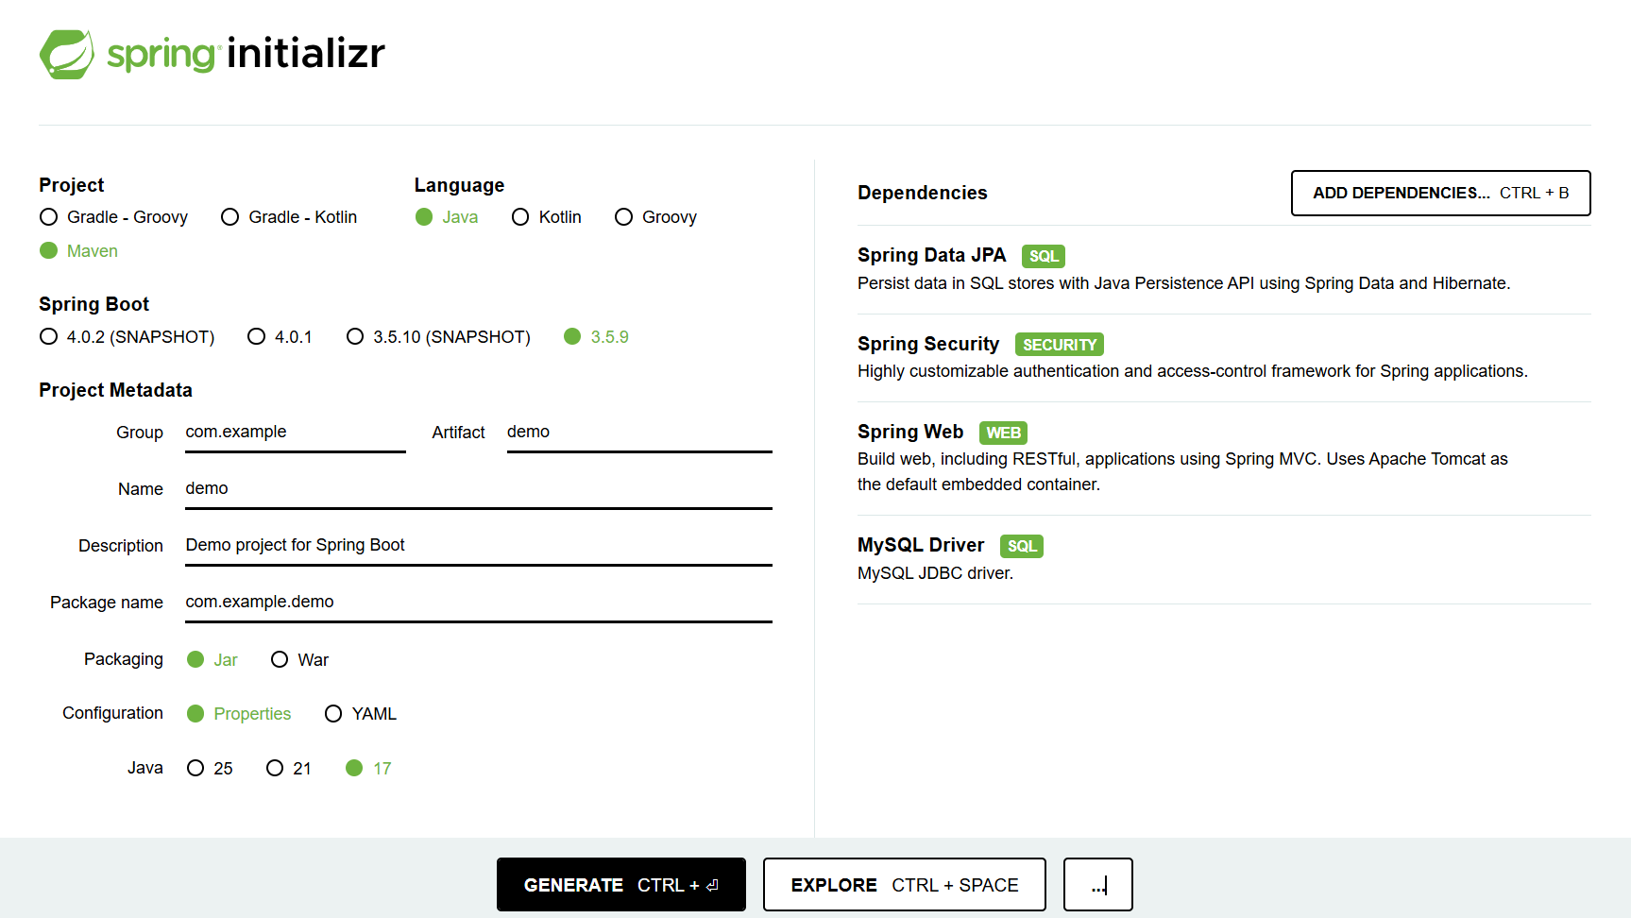
Step 8 : Verify the Application
Check the console: Tomcat started on port 8080
Open browser: http://localhost:8080

Slide 38
What Eclipse “Maven Project” gives you ?
When you create File → New → Maven Project in Eclipse:
You get:
Basic Maven structure
Empty pom.xml
No framework setup
You must do EVERYTHING manually:
Add Spring dependencies
Add Spring Boot parent
Add main class
Configure server
Configure plugins
Configure application startup
Example: NO main class by default

Slide 39
What Spring Initializr gives you (BIG difference)
Spring Initializr gives you:
✔ Ready-to-run project
@SpringBootApplication class
main() method
Embedded server support
Auto-configuration enabled
✔ Preconfigured pom.xml
<parent>
<groupId>org.springframework.boot</groupId>
<artifactId>spring-boot-starter-parent</artifactId>
<version>...</version>
</parent>
✔ Dependency management
✔ Convention over configuration

